Slide 1
Review of the basic of Computer architecture and Operating system
Lecture 1

Slide 2
von Neumann Architecture (1945)
John Von Neumann is usually considered to be the developer of modern computer architecture.
The major guidelines that define a Von Neumann architecture are:
Stored program concept - memory holds both programs and data.
Memory is addressed linearly – i.e address consists of a single number
Memory is addressed without regard to content i.e. it can be an instruction or data.

Slide 3
Von Neumann Architecture (1945)
Instructions are executed sequentially unless an instruction or an outside event cause a branch to occur. (e.g. an if statement )

Slide 4
Von Neumann Architecture
Von Neumann defined the functional organisation of the computer to be made up of:
A control unit that executes instructions
An arithmetic logic unit that performs arithmetic and logical calculations,
Memory locations
Input/output
Communication bus

Slide 5
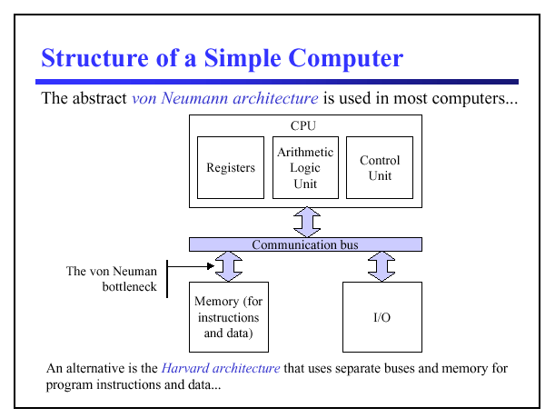

Slide 6
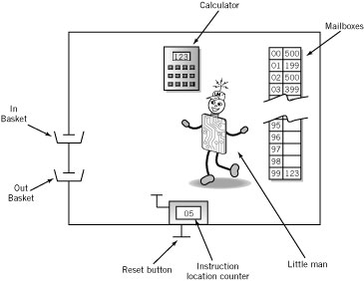
An conceptual version of a von Newman computer: The LMC

Slide 7
Contents of Memory locations
Op code
Operation code
Arbitrary mnemonic
Operand
Object to be manipulated
Data or
Address of data
Address | Content
 | Op code | Operand

Slide 8
Sample Machine code Instruction Set
Arithmetic | 1xx | ADD
 | 2xx | SUBTRACT
Data Movement | 3xx | STORE
 | 5xx | LOAD
Input/Output | 901 | INPUT
 | 902 | OUTPUT
Machine Control (coffee break) | 000 | STOP

Slide 9
Instruction Cycle
Fetch: Little Man finds out what instruction he is to execute
Execute: Little Man performs the work he is instructed to perform

Slide 10
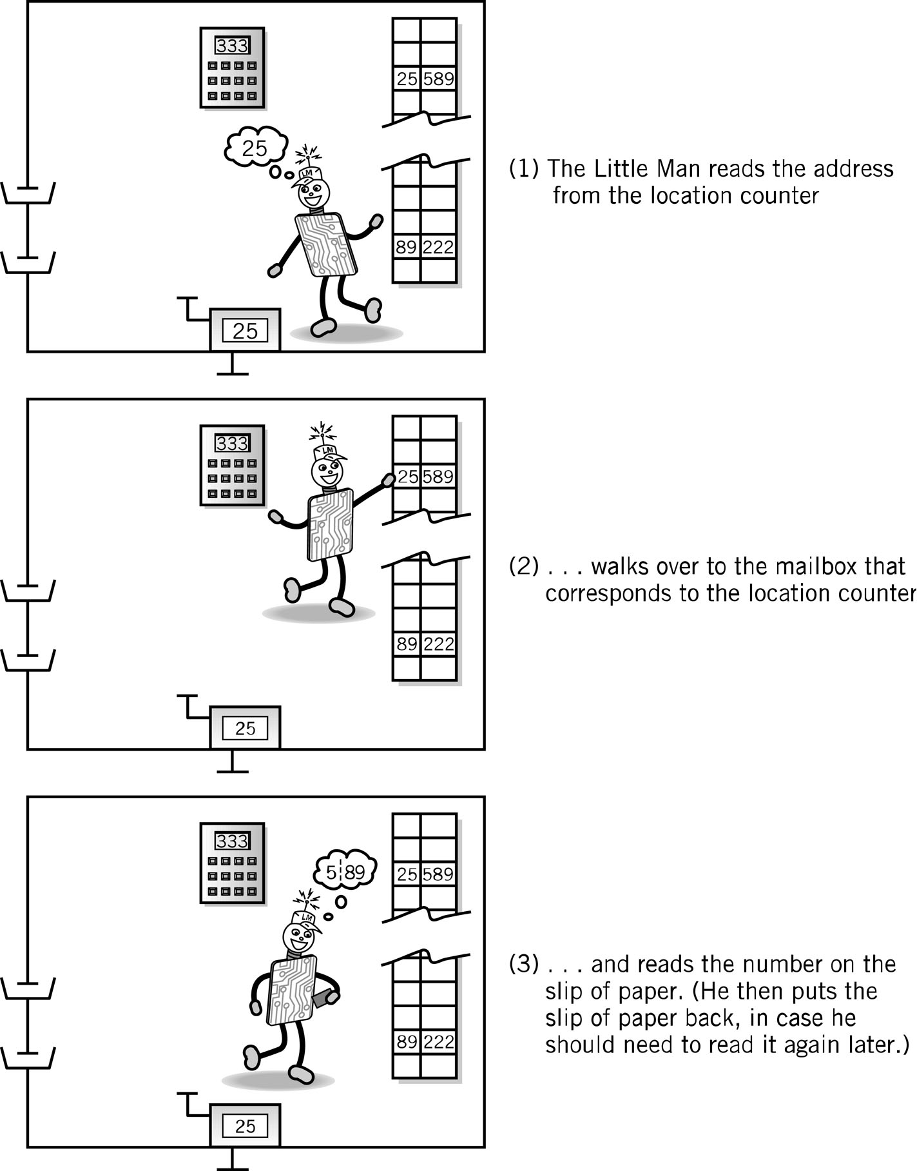
Fetch Portion of Fetch and Execute Cycle
1. Little Man reads the address from the location counter
2. He walks over to the mailbox that corresponds to the location counter

Slide 11
Fetch, cont.
3. And reads (involves knowing the meaning of the op code…) the contents on the slip of paper (he puts the slip back in case he needs to read it again later)

Slide 12
Execute Portion
The execution portion of each instruction is, of course, different for each instruction.
However, even here, there are many similarities.
The load instruction (LDA) is typical. (589: where 5 is the load op-code and 89 refers to the mail box whose contents are loaded into calculator)

Slide 13
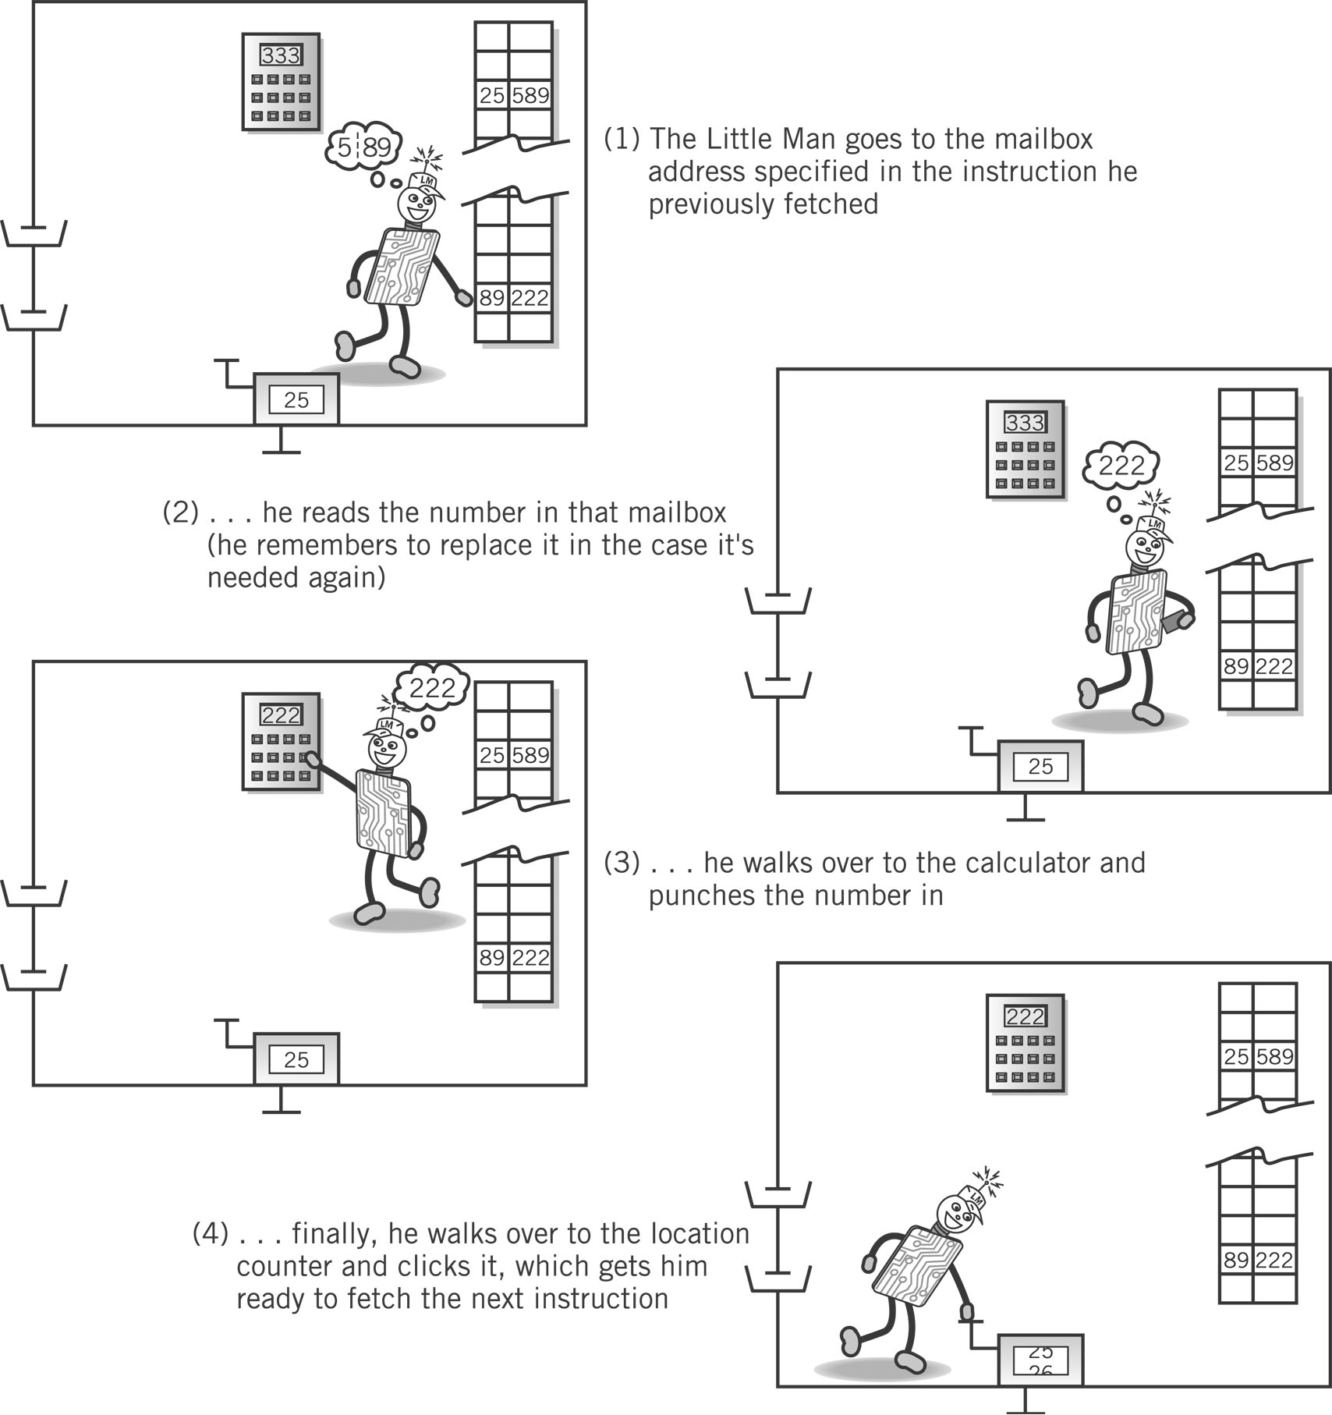
Execute Portion (LDA)
1. The Little Man goes to the mailbox address specified in the instruction he just fetched.
2. He reads the number in that mailbox (he remembers to replace it in case he needs it later).

Slide 14
Execute, cont.
3. He walks over to the calculator and punches the number in.
4. He walks over to the location counter and clicks it, which gets him ready to fetch the next instruction.

Slide 15
An O.S. Architecture
Application Programs
Shell Editors
Kernel
Assembler, loader
Compiler
Hardware

Slide 16
An O.S. Architecture
The hardware is encapsulated by the kernel
It provides systems services to application programs
The user communicates with the kernel via the shell
The user can invoke the C compiler to create applications which can be executed by the kernel

Slide 17
What is an Operating System?
Computer System
Software (programs)
Hardware (physical machine and electronic components)
Operating System
Part of computer system (software)
Manages all hardware and software
Controls every file, device, section of main memory and nanosecond of processing time
Controls who can use the system
Controls how system is used

Slide 18
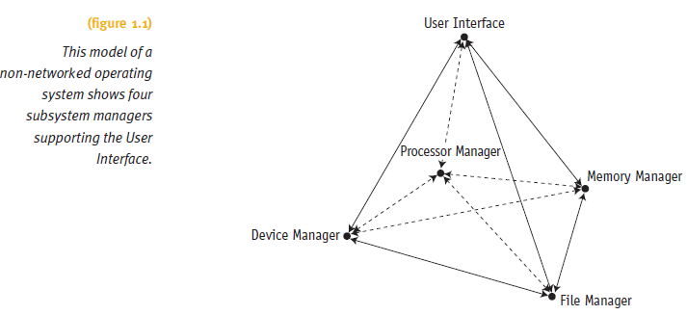
Operating System Software
Includes four essential subsystem managers
Main Memory Manager, Processor Manager
Device Manager and File Manager (hard drives)

Slide 19
Operating System Software (cont'd.)
Each manager:
Works closely with other managers
Performs a unique role
Manager tasks
Monitor its resources continuously
Enforce policies determining:
Who gets what, when, and how much
Allocate the resource (when appropriate)
Deallocate the resource (when appropriate)

Slide 20
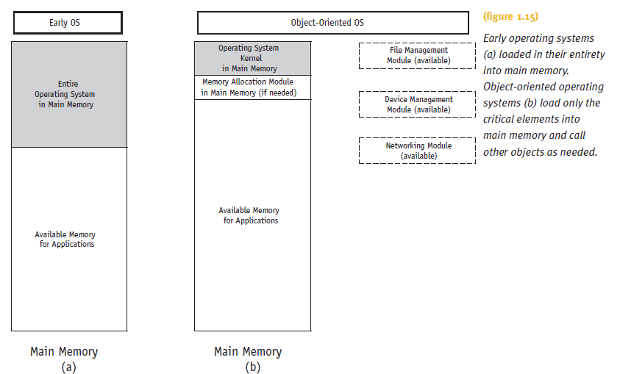
Object-Oriented Design (cont'd.)

Slide 21
Design Considerations
Most common overall goal
Maximize use of the system’s resources
Maximise throughput (memory, processing…)
Minimize downtime
Factors included in developmental efforts
RAM resources
CPUs: number and type available
Peripheral devices: variety likely to be connected
Networking capability
Security requirements, etc.

Slide 22
Potential Exam Questions
What parts of the L.M.C. correspond to the elements of the Von Neumann architecture (4 marks)
Describe how the LMC performs the Fetch and execute cycle (8 marks)

